Slide 1
Financial Analysis of Impact of COVID-19 on Pharmaceutical Companies
STAT 5261 Final Project
Members: Yige Yang, Peiyu Yang, Shiyu Lu, Hongyi Xu
Date: December 2nd, 2022

Slide 2
Introduction
We choose 5 stocks from 5 top pharmaceutical companies to analyze the impact of Covid - 19 from January 2nd, 2018 to November 1st, 2022 via statistical modeling and analysis.
5 stocks: Pfizer (PFE), Johnson & Johnson (JNJ), AbbVie (ABBV), Merk (MRK), Novartis (NVS)
Resource: Yahoo Finance

Slide 3
Outline
Data Description
Portfolio Theory
Copula
Risk Management
Time Series Analysis

Slide 4
Data Description

Slide 5
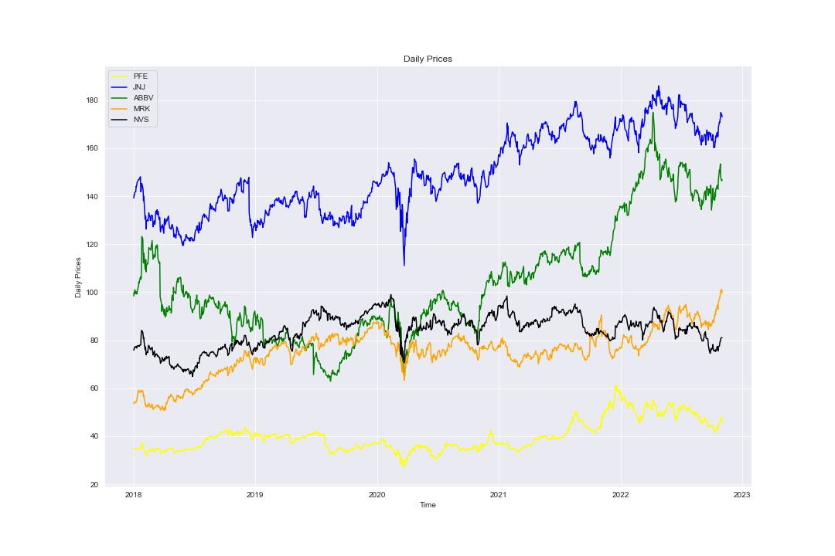
Daily Prices

Slide 6
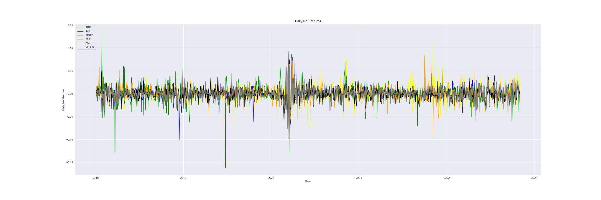
Daily Net Returns

Slide 7
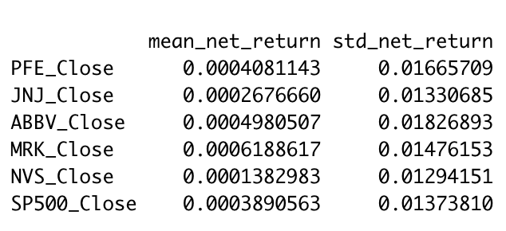
Daily Net Returns

Slide 8
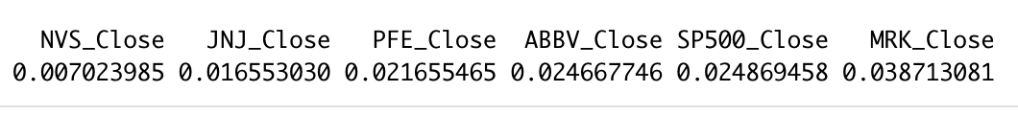
Sharpe Ratio

Slide 9
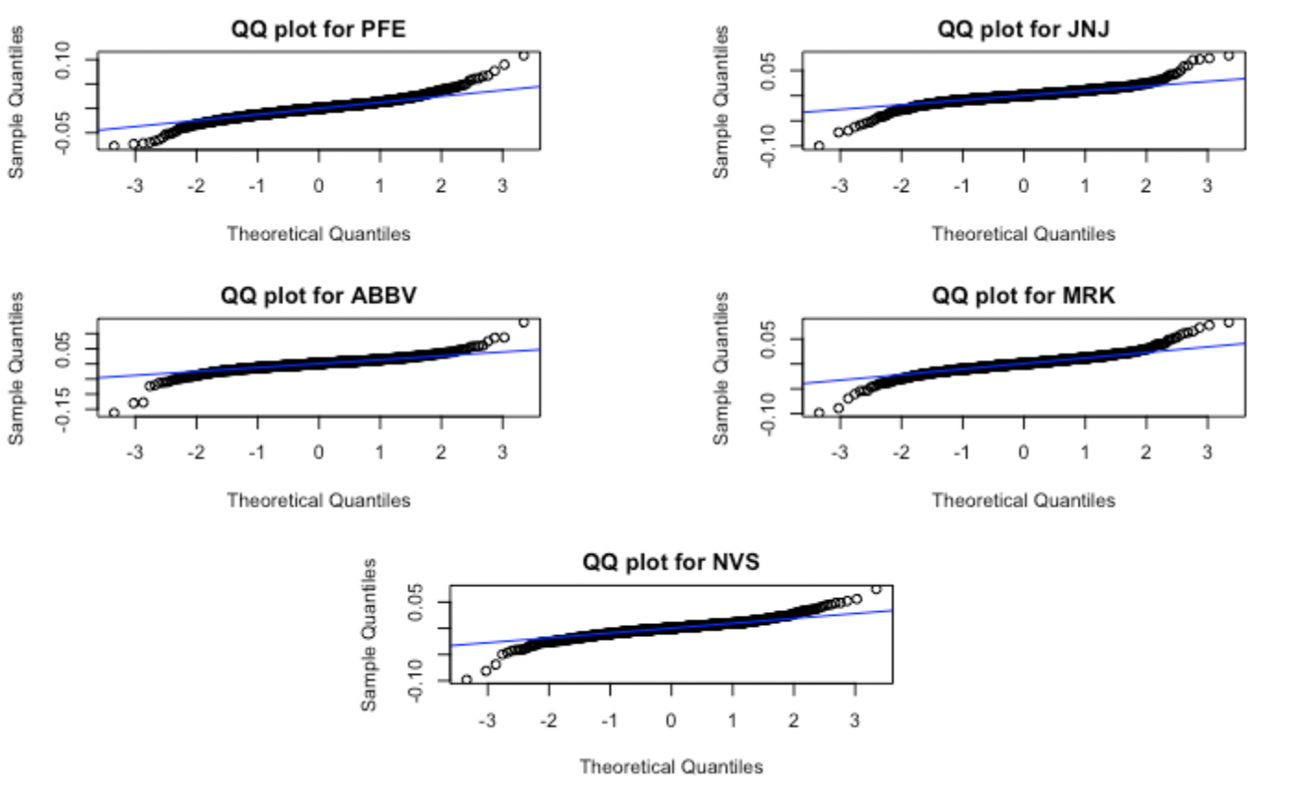
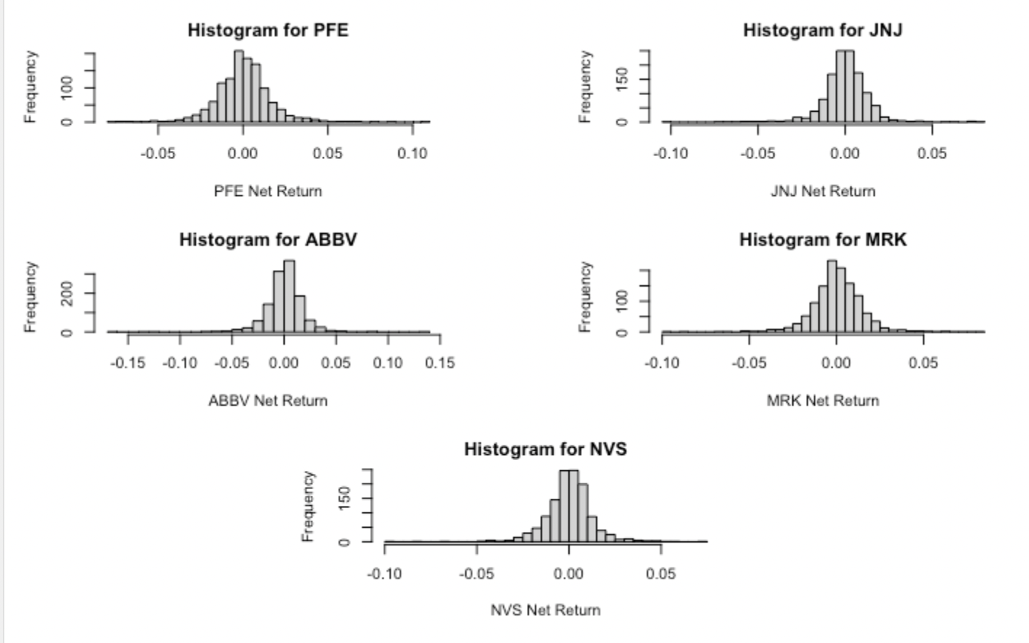
Normality

Slide 10
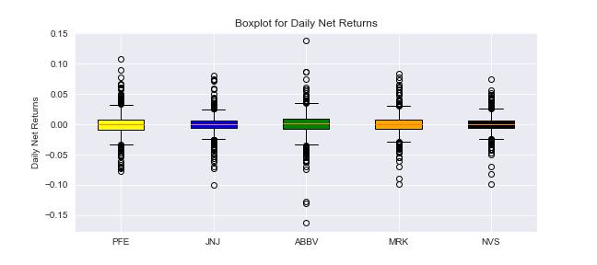
Normality

Slide 11
Portfolio Theory
Notes:
A minimum variance portfolio is an investing method that maximize returns and minimize risk. We can reduce volatility by diversifying holdings, so the investments that may be risky on their own balance each other out when held together.
So by having a collection of stocks that combine together, we can minimize the price volatility of the overall portfolio, and this kind of portfolio is the minimum variance portfolio.
A line with a larger slope gives a higher expected return for a given level of risk, so the larger Sharpe ratio is, the better regardless of what level of risk that anyone is willing to accept. The optimal portfolio of mixing with the risk-free asset is the one with point on the efficient frontier that has the highest Sharpe ratio. This portfolio is called the tangency portfolio since its line is tangent to the efficient frontier. So the tangency portfolio is the portfolio that has the largest sharpe ratio.

Slide 12
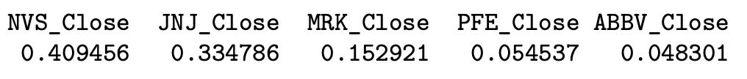
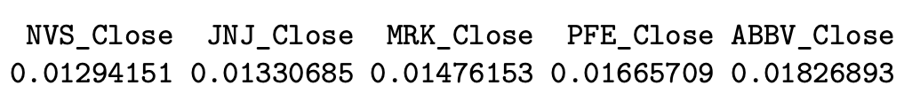
Minimum Variance Portfolio (No Short)
MVP
SD
Notes:
Minimum Variance Portfolio gives more weight to stocks that have lower volatility, volatility is a measure of a stock's price movement, which is the variance, so it also means to have lower standard deviation. So we can see the standard deviation of these five stocks from low to high corresponds to the weight in MVP from high to low. Among these five stocks, Novartis has the largest weight in the minimum variance portfolio.

Slide 13
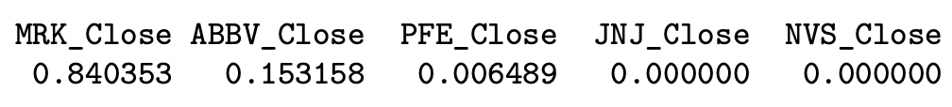
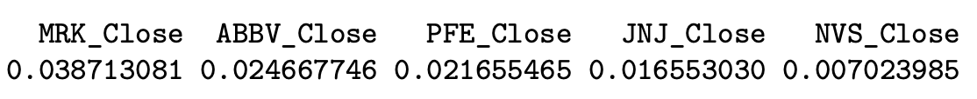
Tangency Portfolio (No Short)
Tangency Portfolio
Sharpe Ratio
Notes:
Tangency portfolio gives more weights on stocks that have larger sharpe ratio. We can see the stocks that have higher sharpe ratio have more weights on the tangency portfolio. Among these 5 stocks, Merk have the largest weights in the portfolio.

Slide 14
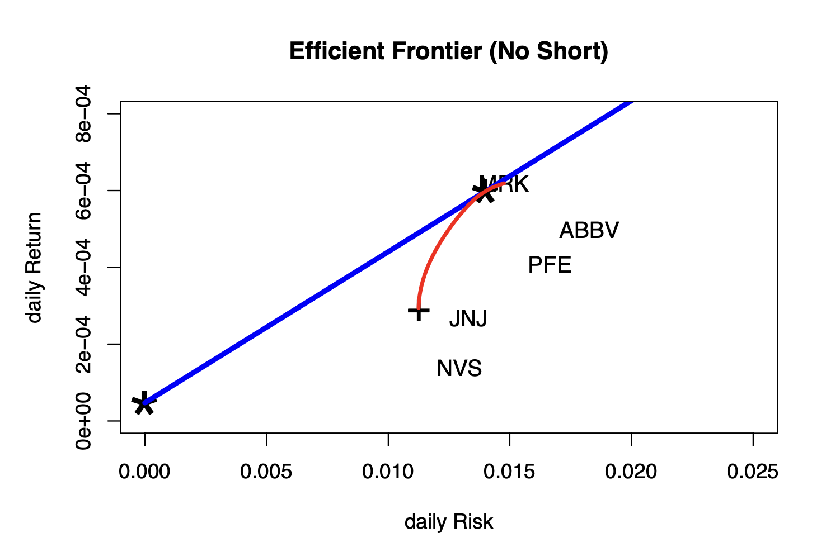
Efficient Frontier (No Short)
Notes:
The star mark at the lower end of the blue line is the risk-free rate. The star mark at the upper part of the blue line is the tangency portfolio. The plus mark at the lower end of red line is MVP.

Slide 15
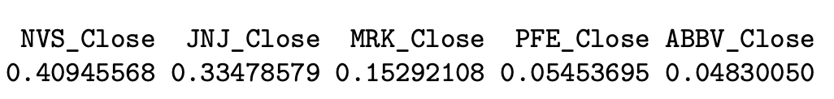
Minimum Variance Portfolio (Short)
MVP
SD
Notes:
The weight of each stock in the minimum variance portfolio is similar to the weight in mvp which short is not allowed.

Slide 16
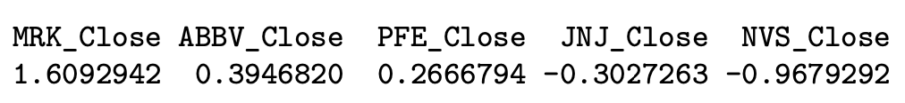
Tangency Portfolio (Short)
Tangency Portfolio
Sharpe Ratio
Notes:
The weight of each stock in the tangency portfolio has changed significantly comparing to the weight in tangency portfolio which short is not allowed. In this portfolio, we have negative weights for Johnson & Johnson and Novartis. Since in this portfolio, short is allowed, it means we need to short corresponding weights for these two stocks.

Slide 17
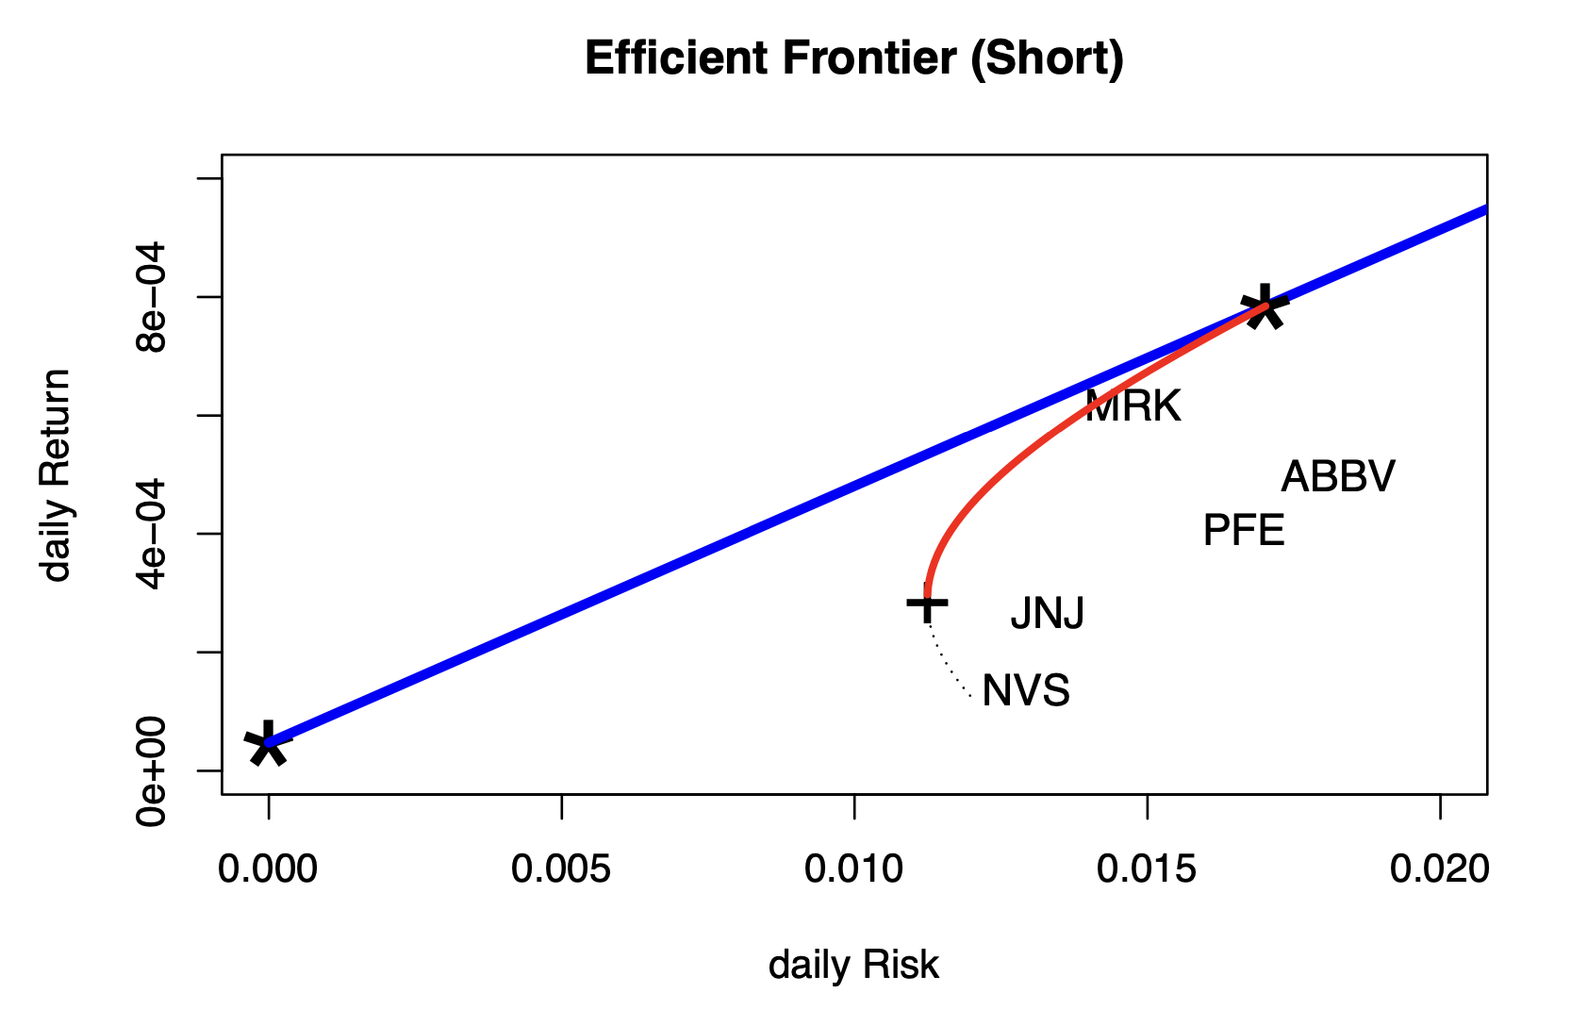
Efficient Frontier (Short)
Notes:
The star mark at the lower end of the blue line is the risk-free rate. The star mark at the upper part of the blue line is the tangency portfolio. The plus mark at the lower end of red line is MVP.

Slide 18
Copula

Slide 19
Copula
Copula | Normal | T | Gumbel | Frank | Clayton
AIC | -1611.921 | -1632.263 | -1247.538 | -1357.236 | -1235.025
BIC | -1606.816 | -1622.053 | -1242.433 | -1352.131 | -1229.92
Likelihood | 806.9603 | 818.1316 | 624.7688 | 679.6182 | 618.5125

Slide 20
Copula
Lowest AIC value: T copula
Lowest BIC value: T copula
Highest likelihood: T copula
Choose T copula for model
Notes:
T copula usual fits data with heavy tail, so it’s reasonable to think we have data with heavy tails with extreme results.

Slide 21
Risk Management
—— Assume having $100,000 to invest

Slide 22
Risk Management – One Asset
Value at Risk:
the 95% worst-case loss over one day
 | PFE | JNJ | ABBV | MRK | NVS
Normal distr VaR | 2697.911 | 2161.117 | 2953.932 | 2365.172 | 2113.985
T-distr VaR | 2495.908 | 1838.699 | 2502.070 | 2103.726 | 1903.058
Non-parametric VaR | 2408.359 | 1885.457 | 2576.489 | 2104.973 | 2006.720

Slide 23
Risk Management – One Asset
2. Expected Shortfall
the expected loss in the worst 5% case over one day
 | PFE | JNJ | ABBV | MRK | NVS
Normal distr ES | 3393.656 | 2716.927 | 3717.003 | 2981.743 | 2654.536
T-distr ES | 3924.809 | 3035.851 | 4025.226 | 3292.902 | 3076.322
Non-parametric ES | 3718.698 | 3257.832 | 4405.698 | 3370.176 | 3024.341

Slide 24
Risk Management – Portfolio of Assets
Without Short | MVP | Tangency portfolio
Normal distr VaR | 1820.3 | 2246.993
Non-parametric VaR | 1720.916 | 2050.708
With Short | MVP | Tangency portfolio
Normal distr VaR | 1820.298 | 3740.305
Non-parametric VaR | 1720.915 | 3388.672

Slide 25
Time Series Analysis

Slide 26
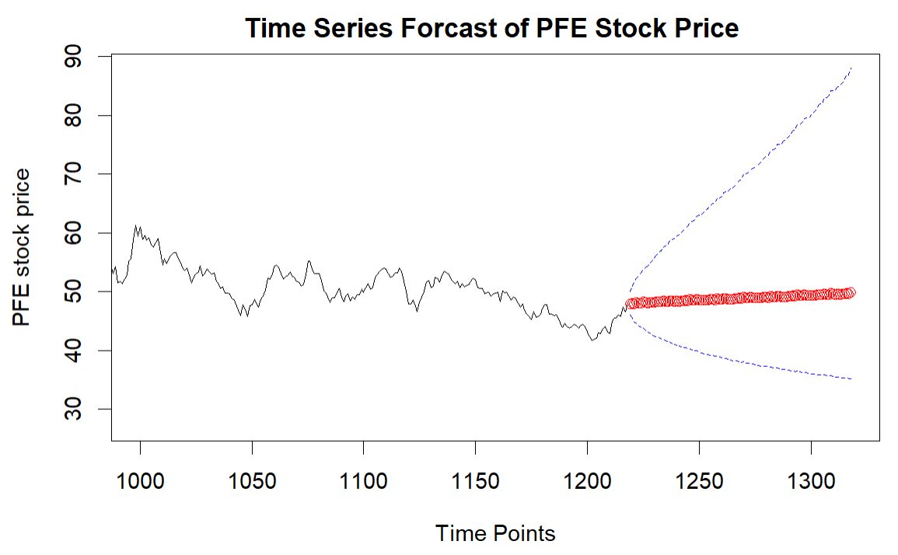
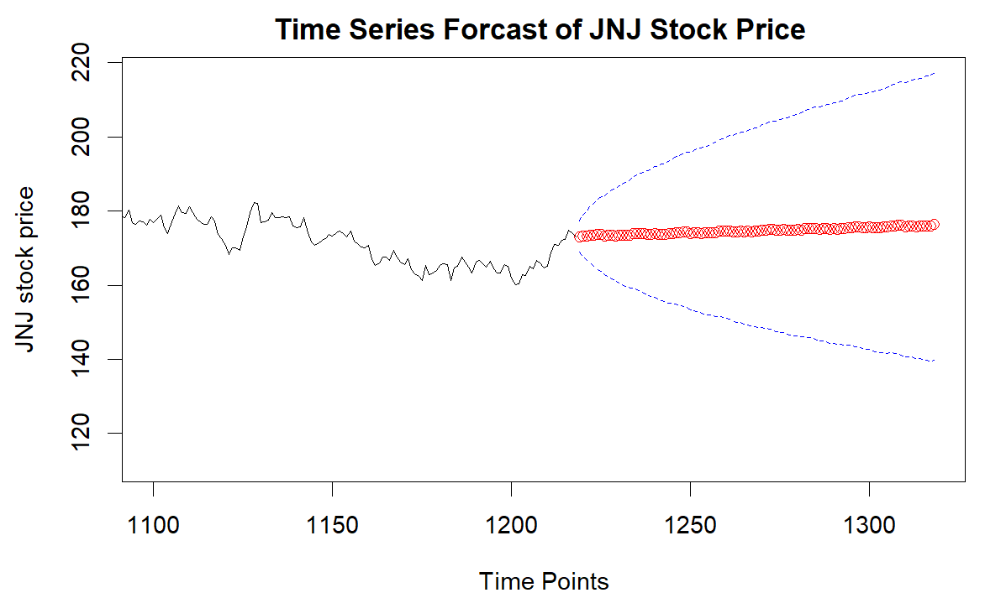
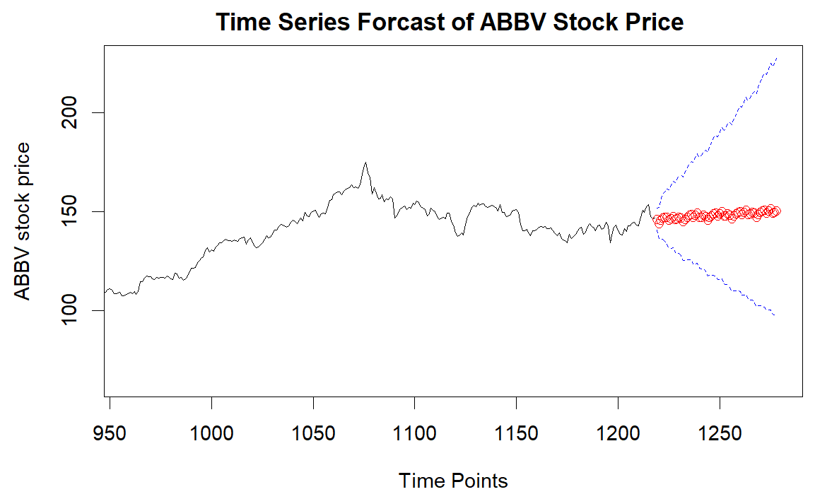
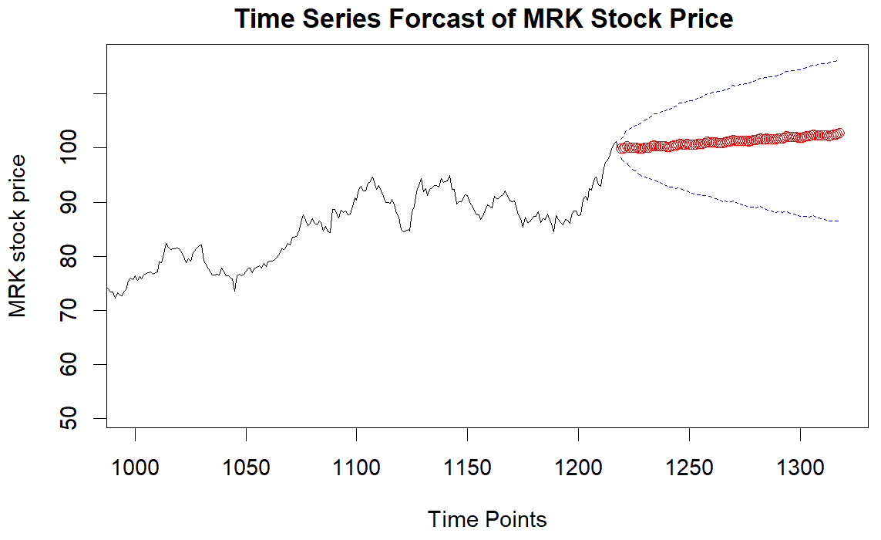
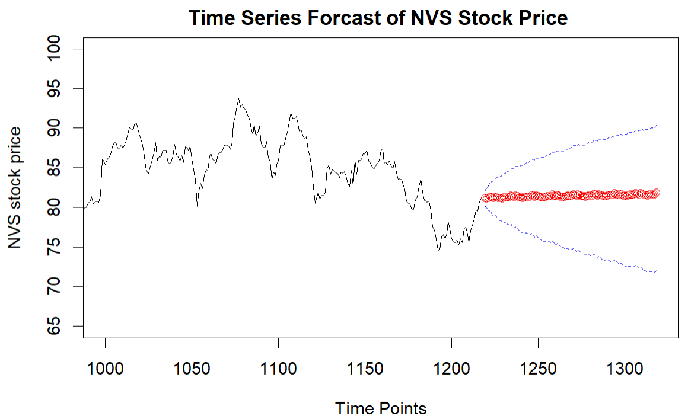
Time Series Analysis
SARIMA (1,1,0) × (1,1,1)

Slide 27
Thank You!

